Slide 1
RENT PAY: DIGITAL RENTAL PROPERTY PAYMENT AND MANAGEMENT SYSTEM
PREPARED BY: GROUP NUMBER FOUR

Slide 2
INTRODUCTION AND PROBLEM STATEMENT
Introduction
RentPay is a web-based platform that helps landlords and tenants manage rental properties online. It allows users to search for houses, make rent payments, manage bookings, and improve communication.
Problem Statement
Manual rent collection is slow.
Finding rental houses takes time.
Payment records are easily lost.
Poor communication between tenants and landlords.

Slide 3
Objectives & Scope
General Objective
To develop a secure online platform for managing rental properties and rent payments.
Specific Objectives
Allow tenants to search houses.
Enable online rent payment.
Help landlords manage properties.
Improve communication.
Provide secure payment through escrow.

Slide 4
System Users
Visitor
Browse properties
Register
Tenant
Search houses
Book rooms
Pay rent
Request maintanance
Landlord
Add property
Mnage rooms
Approve bookings
View reports
Admin
Verify landlords
Resolve disputes
Manage users

Slide 5
Major features
User registration
Property Search
Booking System
Booking System
Online Payment
Escrow System
Maintenance Requests
Reports
Notifications

Slide 6
Functional and Non – Functional requirements
Functional requirements Non – Functional requirements
Register/Login
Add Property
Search Property
Book Room
Pay Rent
Generate Receipt
Security
Performance
Reliability
Availability

Slide 7
Technology Stack
Frontend
HTML
CSS
Backend
PHP
Database
MySQL
API
M – PESA Daraja

Slide 8
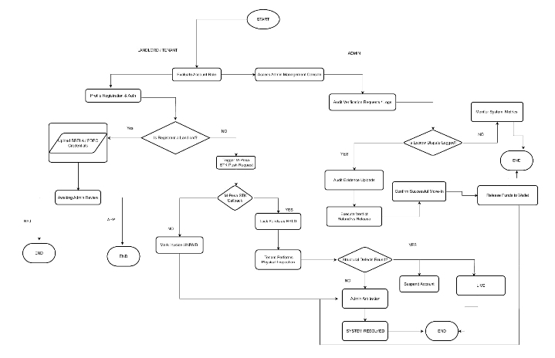
Data Flow

Slide 9
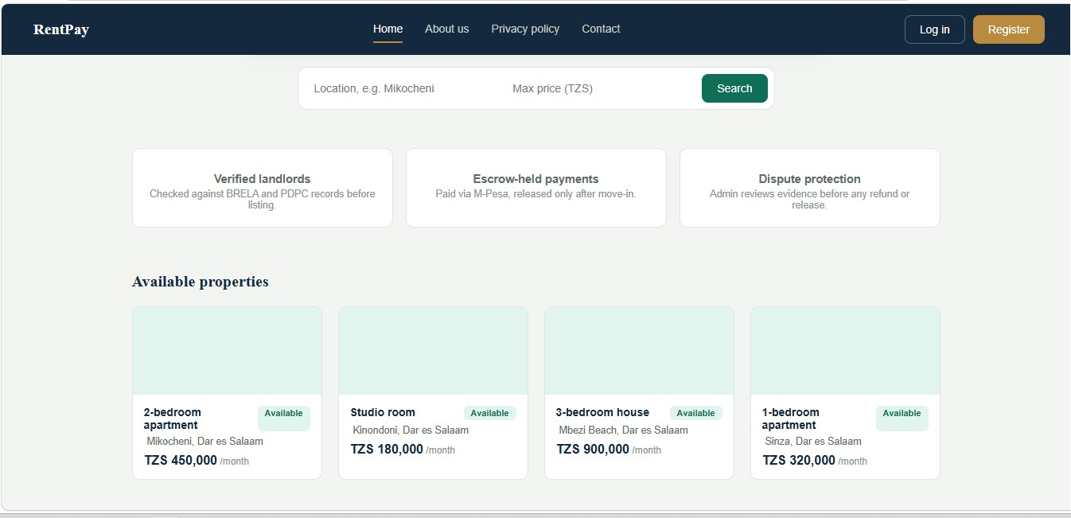
Visitor and Tenant workflow
Home page

Slide 10
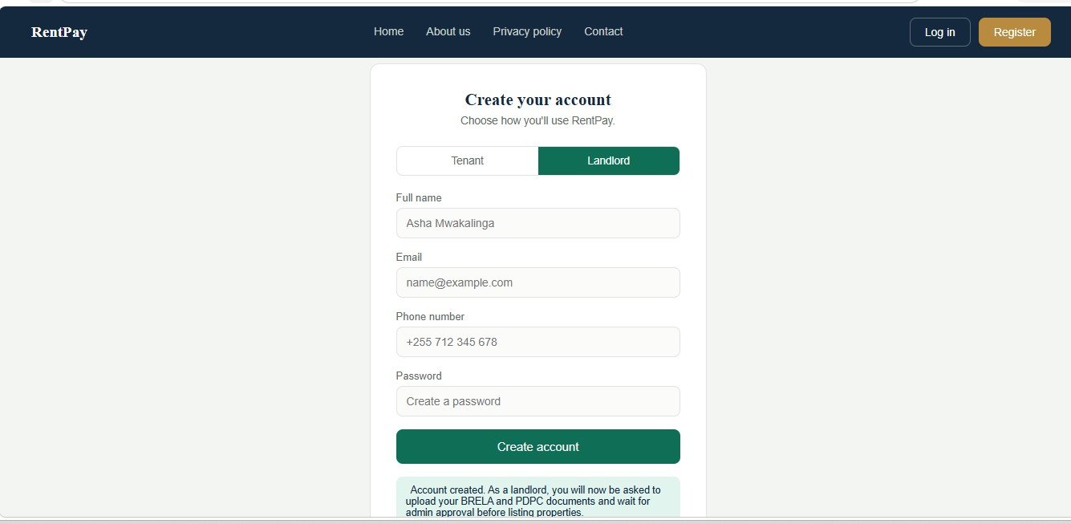
Visitor and Tenant workflow
Register

Slide 11
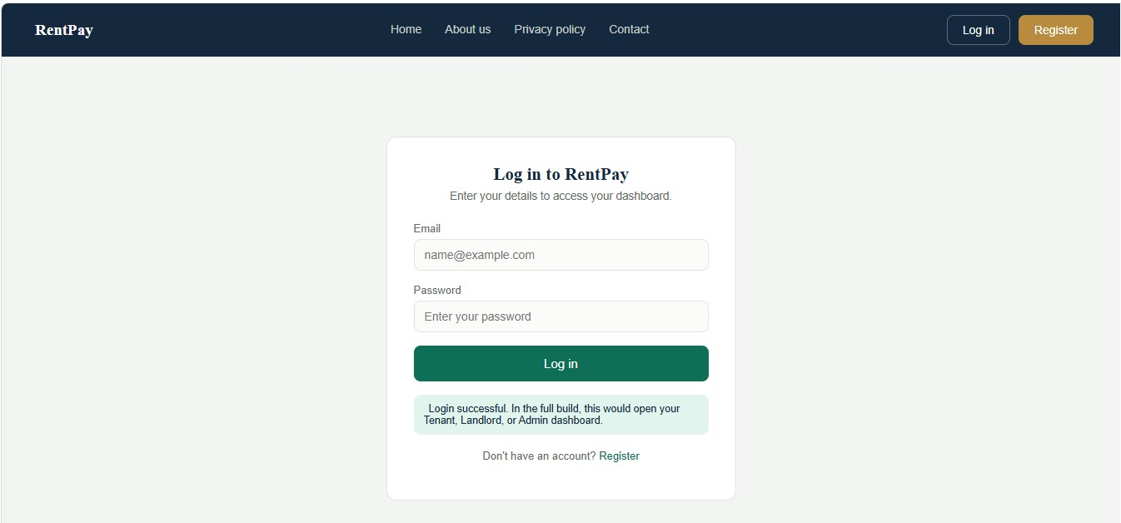
Visitor and Tenant workflow
Login

Slide 12
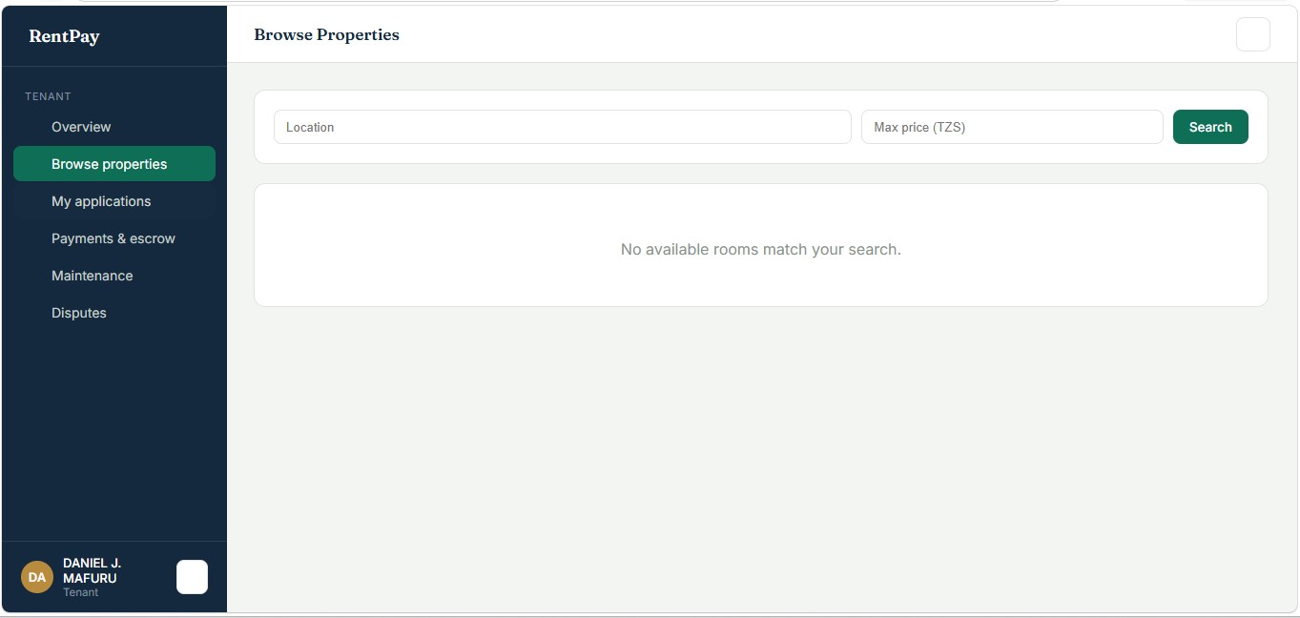
Visitor and Tenant workflow
Search property

Slide 13
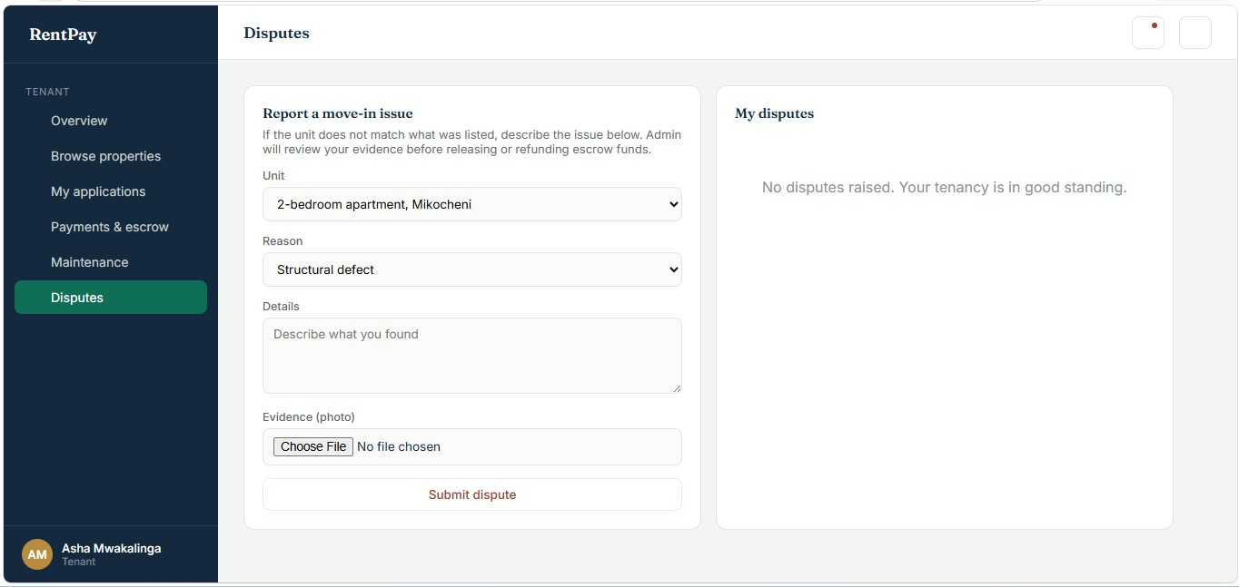
Visitor and Tenant workflow
Property details

Slide 14
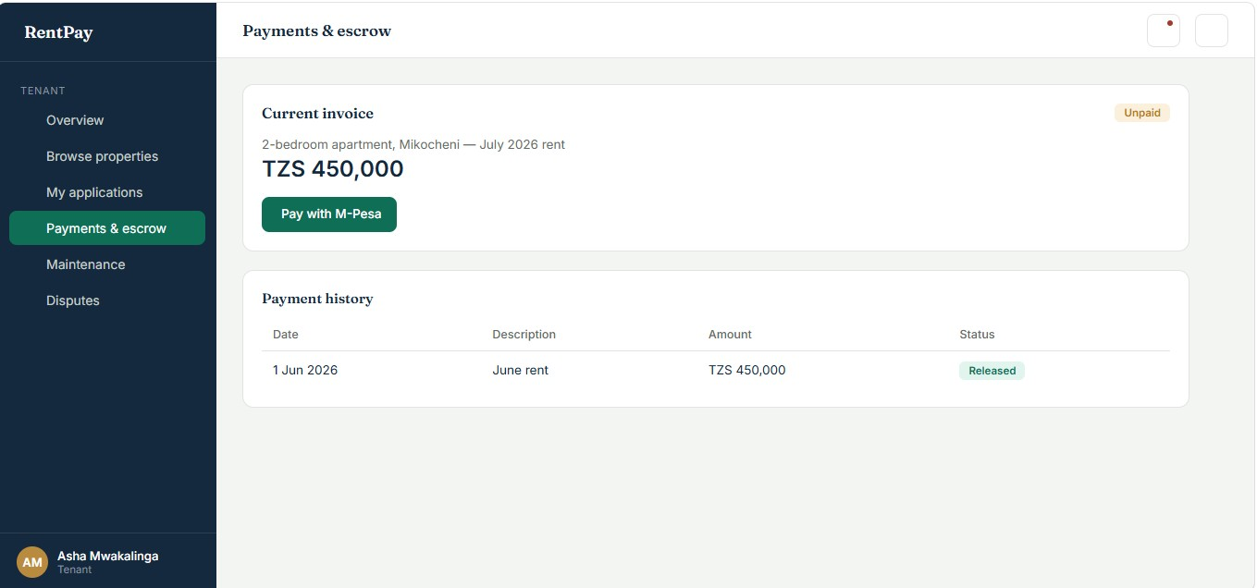
Tenant Booking & Payment
Payment

Slide 15
Tenant Booking & Payment
Agreement

Slide 16
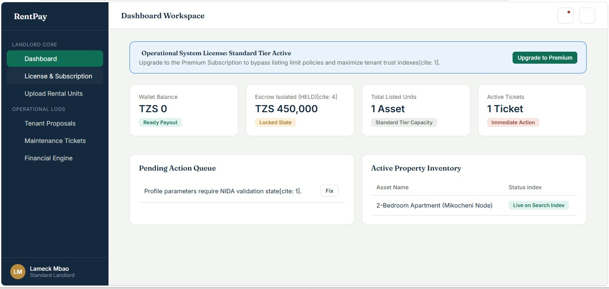
Landlord Workflow
Dashboard

Slide 17
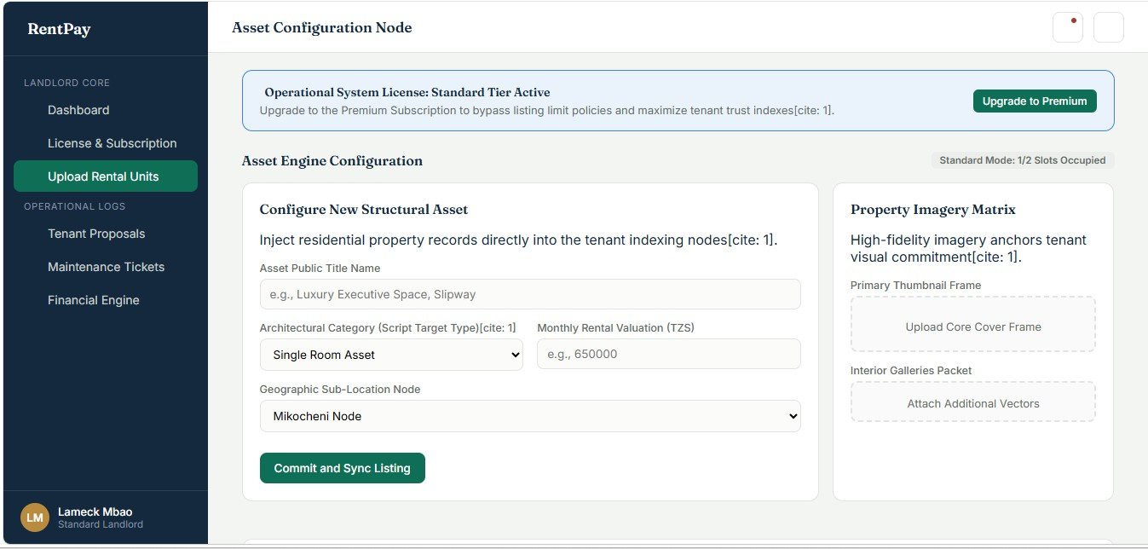
Landlord Workflow
Add property

Slide 18
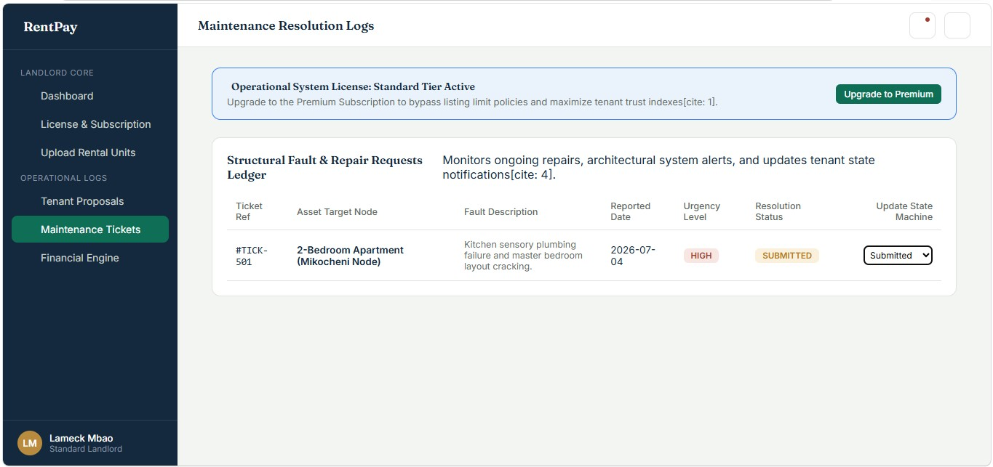
Landlord Workflow
Maintainance and subscription

Slide 19
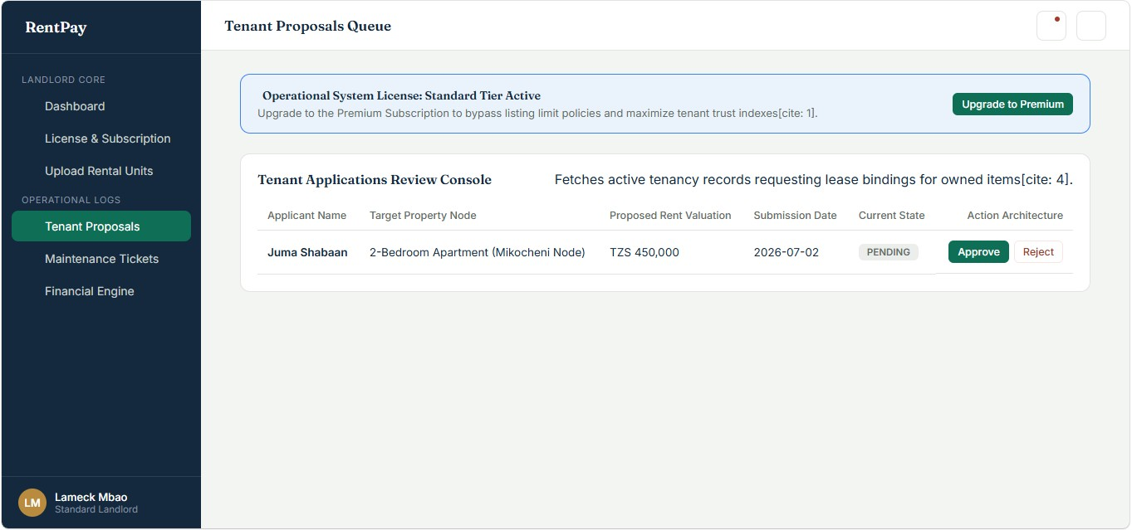
Landlord Workflow
Tenant proposals

Slide 20
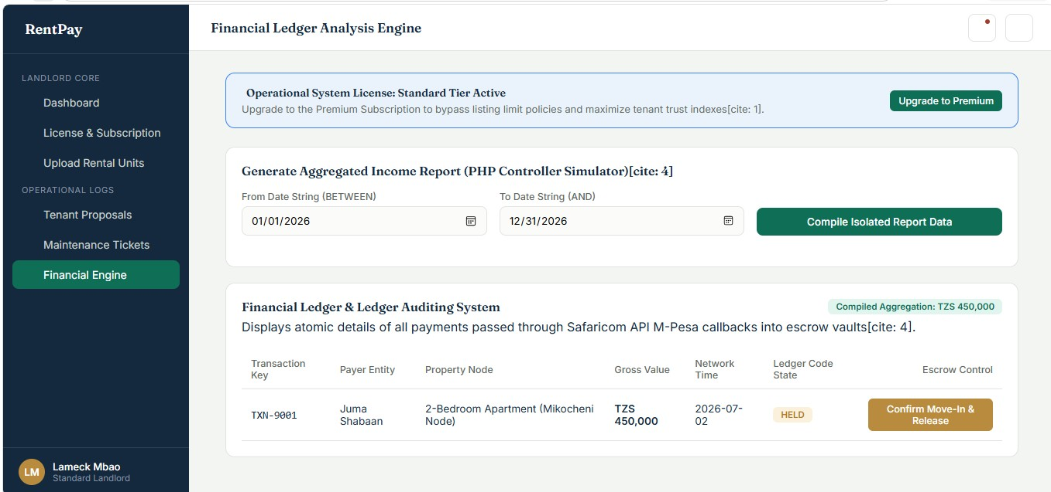
Landlord Workflow
Financial analysis

Slide 21
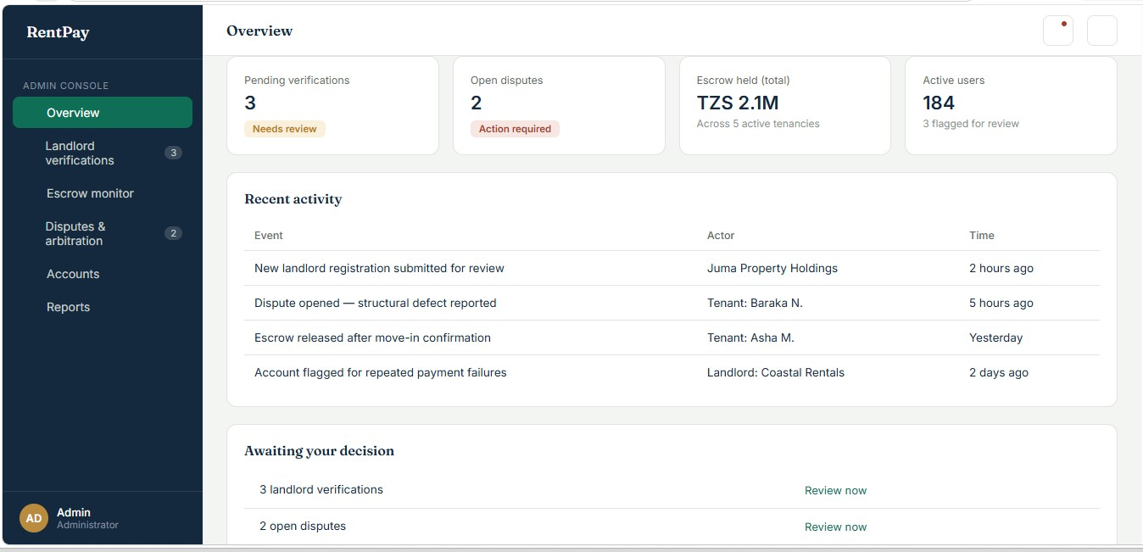
Admin Workflow
Dashboard

Slide 22
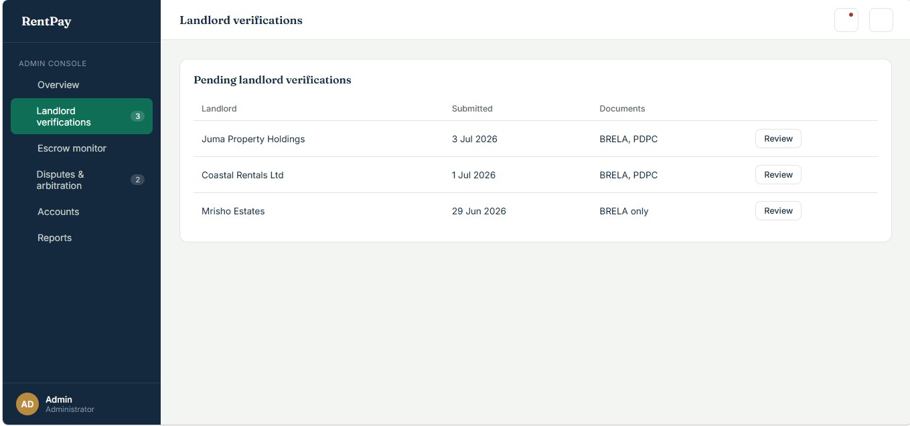
Admin Workflow
Verify landlord

Slide 23
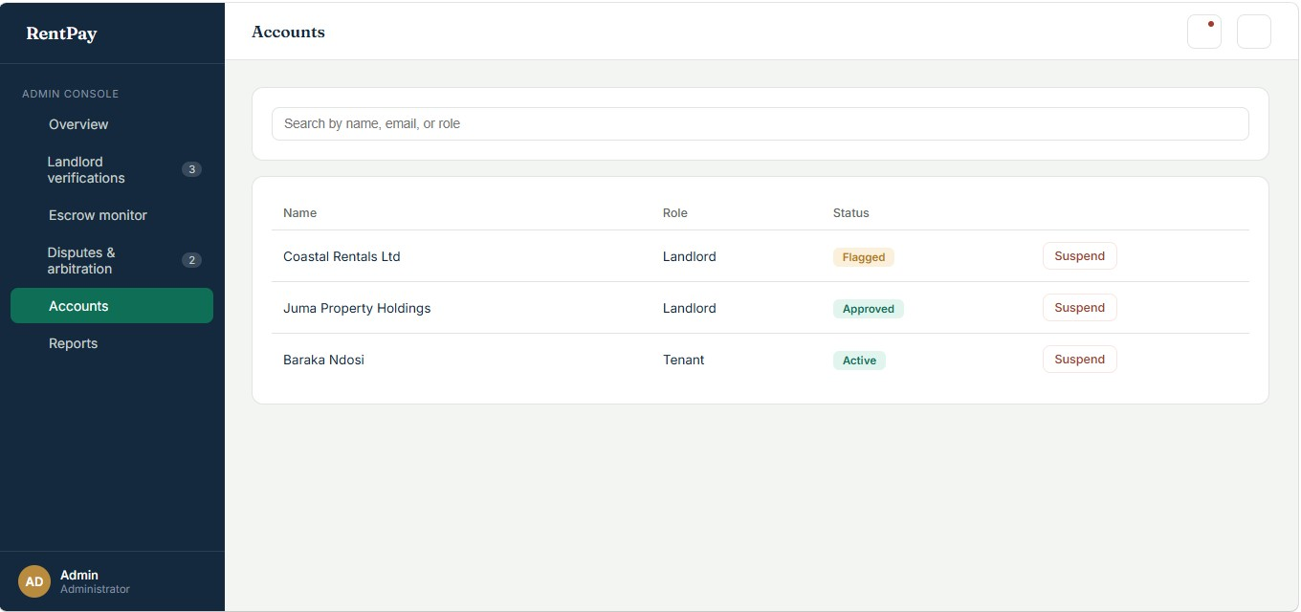
Admin Workflow
Manage users

Slide 24
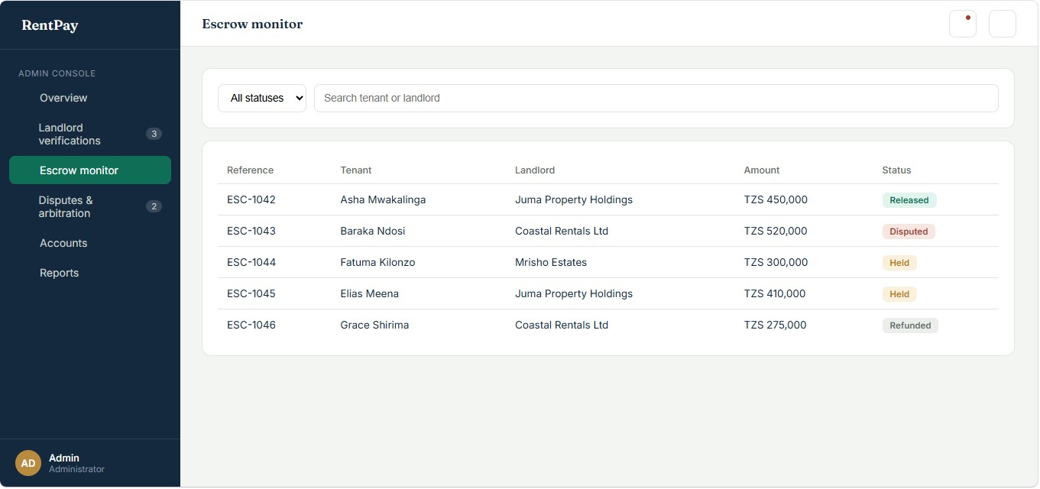
Admin Workflow
Escrow Monitoring

Slide 25
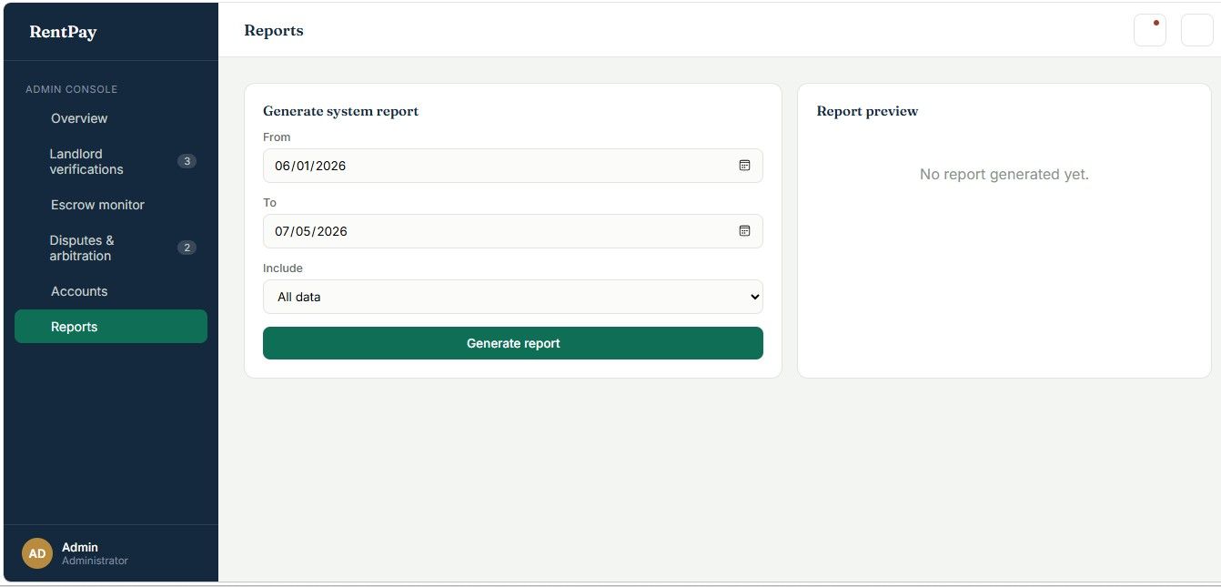
Admin Workflow
Reports Generation

Slide 26
Security and Escrow
Security Features
Escrow Process
Login Authentication
Password Encryption
Role-Based Access
Secure Database
Input Validation
Tenant Pays
↓
Money Held in Escrow
↓
Tenant Confirms Move-in
↓
Landlord Receives Payment

Slide 27
Security and Escrow
Example of escrow

Slide 28
Challenges and Future Improvements
Challenges
Future Improvements
Internet dependency
Payment API integration
User verification
Mobile App
SMS Notifications
Online Video Viewing
AI Property Recommendation

Slide 29
Conclusion
Conclusion
RentPay provides a secure and simple way for landlords and tenants to manage rental properties online. It improves transparency, simplifies payments, and enhances communication while reducing manual work.

Slide 30
Thank you

